Slide 1


Automatic Fraud Detection
Data Pipelines for AI

Slide 2
Context
Problem: Fraudulent credit card transactions
Need real-time fraudulent transactions identification
Development of a scalable production-ready infrastructure
Provide analytics and notifications when fraud occurs

Slide 3
Context
Tasks
Problem: Fraudulent credit card transactions
Train machine learning models on historical transactions dataset
Need real-time fraudulent transactions identification
Design an infrastructure to integrate the models with real-time data
Development of a scalable production-ready infrastructure
Deploy the infrastructure components
Provide analytics and notifications when fraud occurs
Machine learning models
ETL pipeline
Data storage
Data consumer

Slide 4
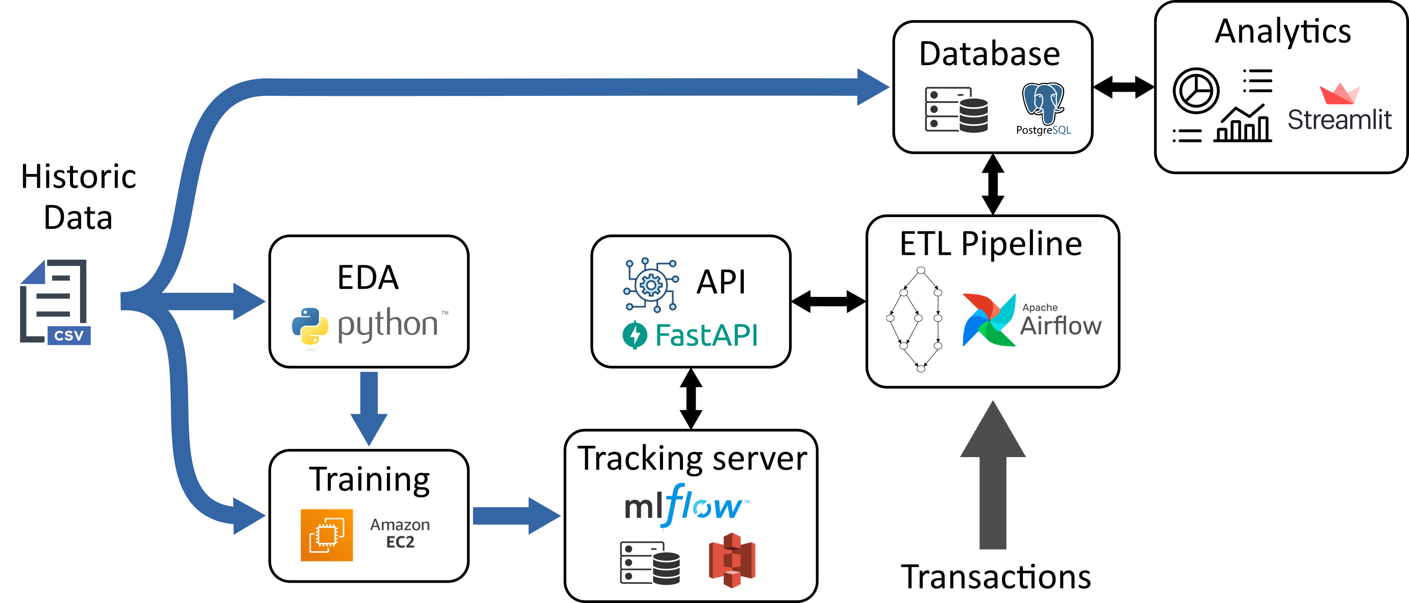
Pipeline architecture

Slide 5
Pipeline architecture

Slide 6
Pipeline architecture

Slide 7
Pipeline architecture

Slide 8
Pipeline architecture

Slide 9
Pipeline architecture

Slide 10
Pipeline architecture

Slide 11
Pipeline architecture

Slide 12
Pipeline architecture

Slide 13

Pipeline architecture
Servers deployment on

Slide 14
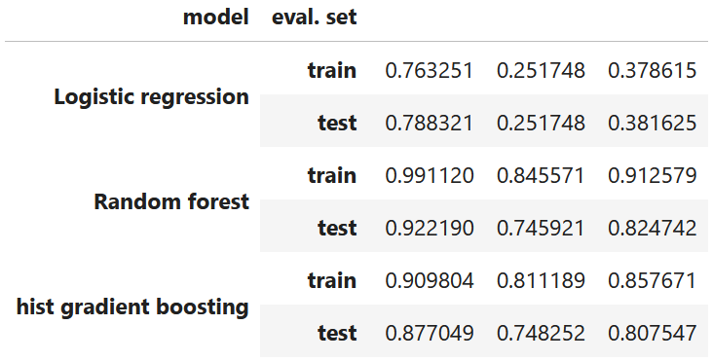
Fraud detection service
Model design (scikit-learn)

Slide 15
Fraud detection service
Model design (scikit-learn)

Slide 16
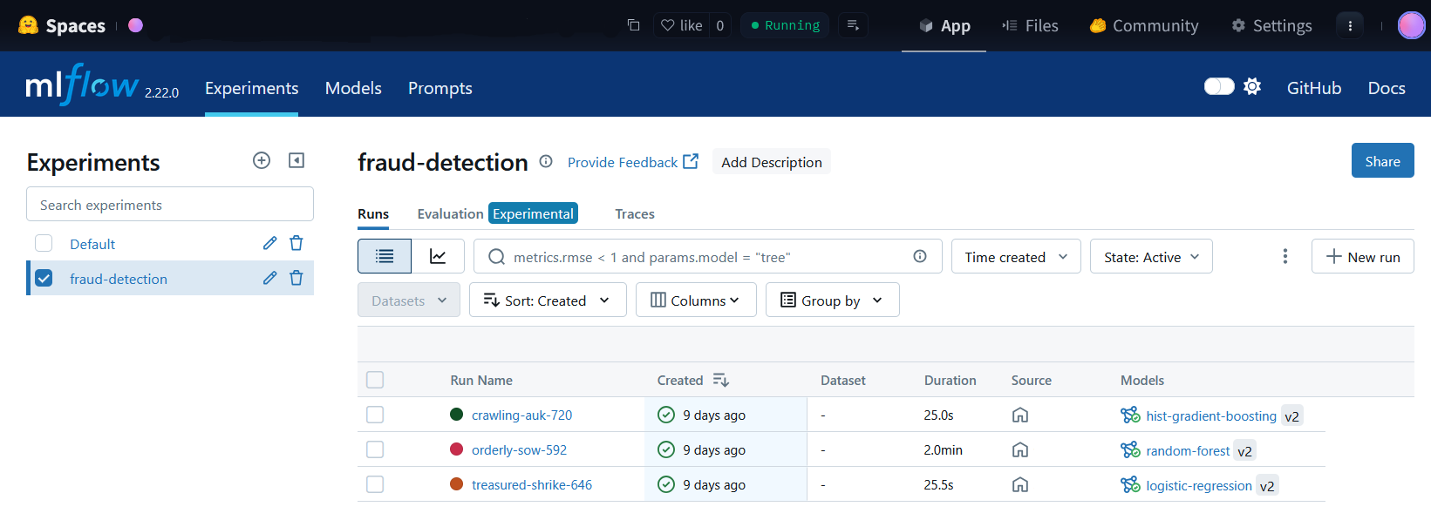
Fraud detection service
Model design (scikit-learn)
Training and tracking (MLflow)

Slide 17
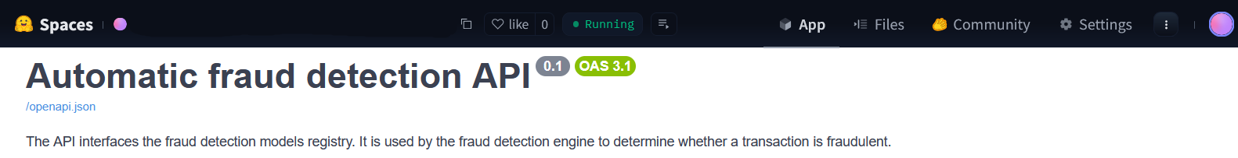
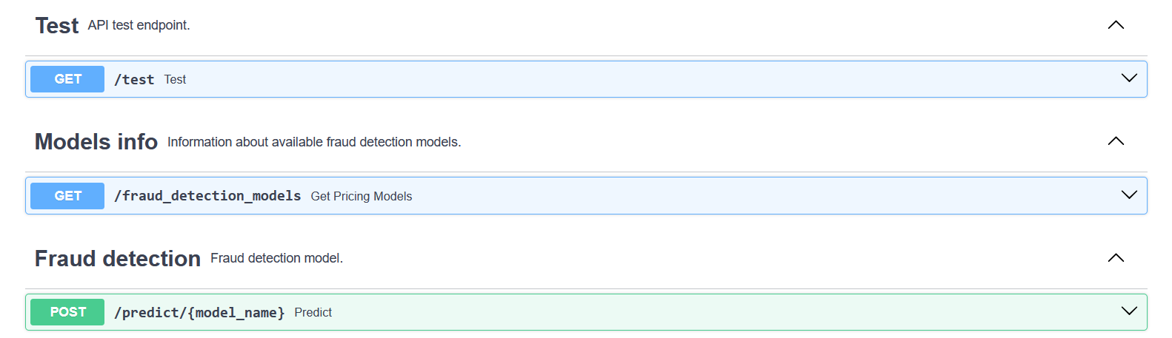
Fraud detection service
Model design (scikit-learn)
Training and tracking (MLflow)
Fraud detection API (FastAPI)

Slide 18
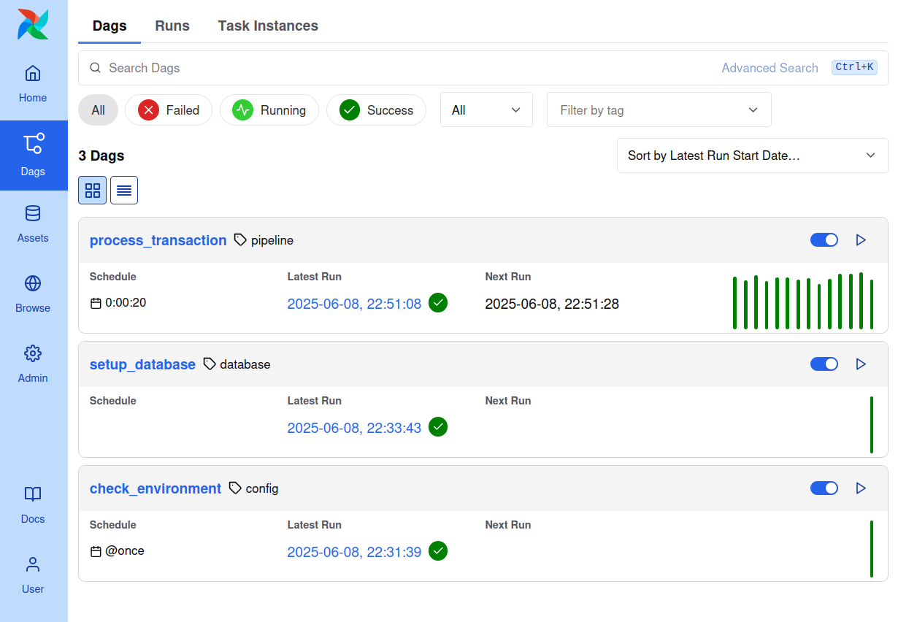
ETL pipeline
Workflow orchestration with Airflow
Task DAGs
check_environment (admin.)
setup_database (admin.)
process_transaction (ETL)

Slide 19
ETL pipeline
Workflow orchestration with Airflow
Task DAGs
check_environment (admin.)
setup_database (admin.)
process_transaction (ETL)

Slide 20
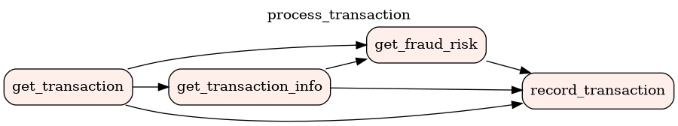
ETL pipeline
ETL : process_transaction
Fetch real-time transaction
Get additional information from database (e.g., transaction id)
Request fraud detection API
Record transaction in database

Slide 21
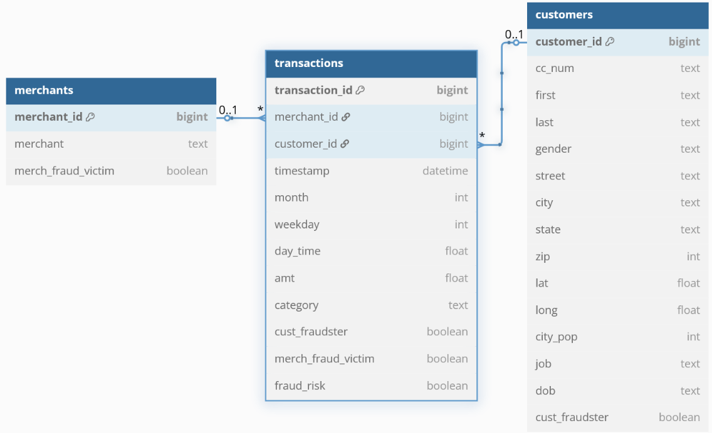
ETL pipeline
ETL : process_transaction
Storage in SQL database
Fetch real-time transaction
Get additional information from database (e.g., transaction id)
Request fraud detection API
Record transaction in database
customers (reference)
merchants (reference)
transactions (transactional)

Slide 22
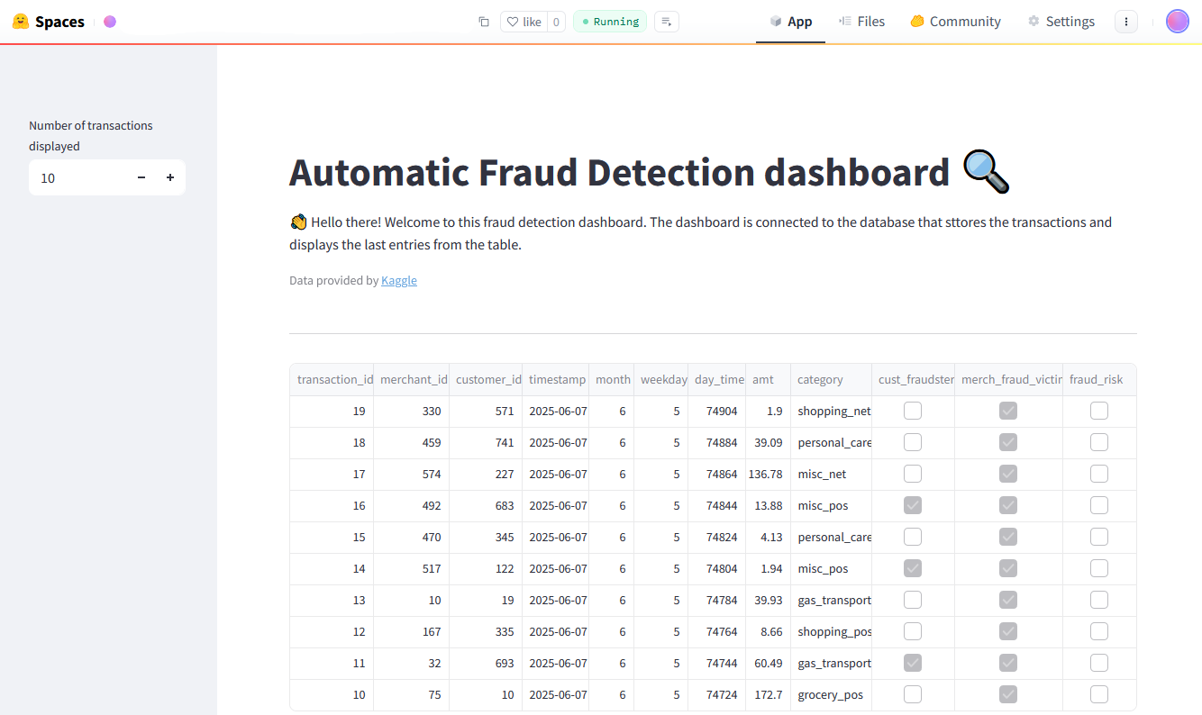
Dashboard
Check database availability at startup
Fetch last transactions from database
Display transactions in a table

Slide 23

Thanks!

